Slide 1
Getting Started With Programming

Slide 2
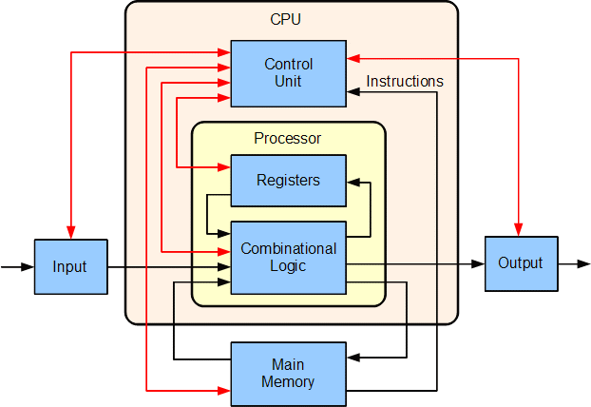
Computer

Slide 3
How do we interact with Computer

Slide 4
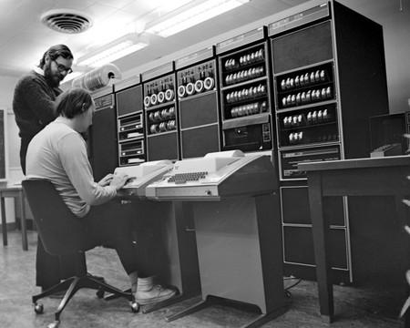
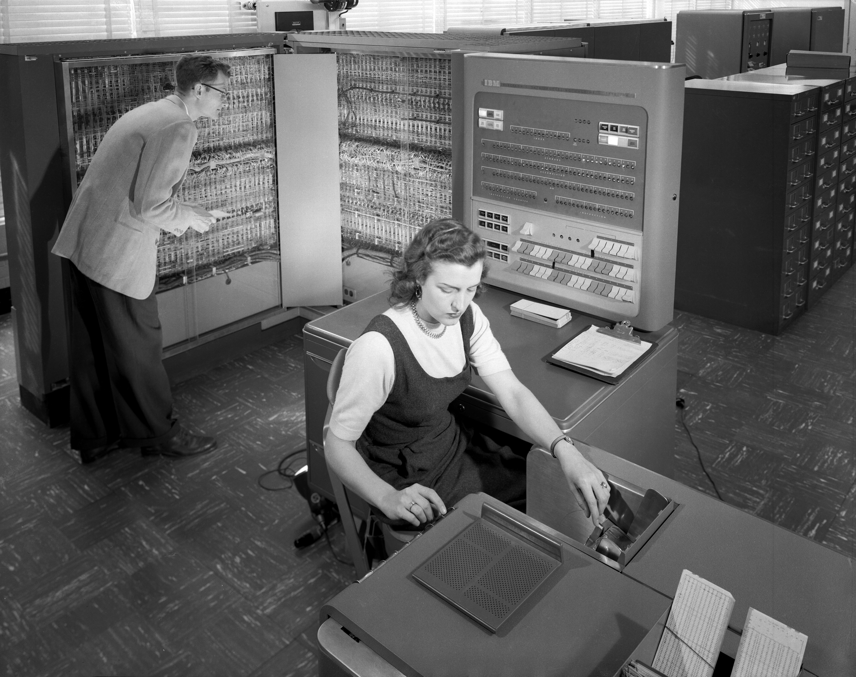
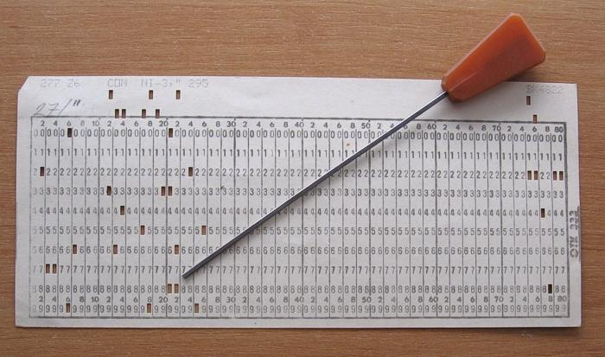
Operating System (History)
The earliest computers were mainframes that lacked any form of operating system.
Operating systems did not exist in their modern and more complex forms until the early 1960s.
The first operating system used for real work was GM-NAA I/O, produced in 1956 by General Motors' Research division for its IBM 704.
1969: UNIX: laid the foundations of today's operating systems (Linux, Mac OS X, NeXTSTEP, OpenBSD etc.)

Slide 5
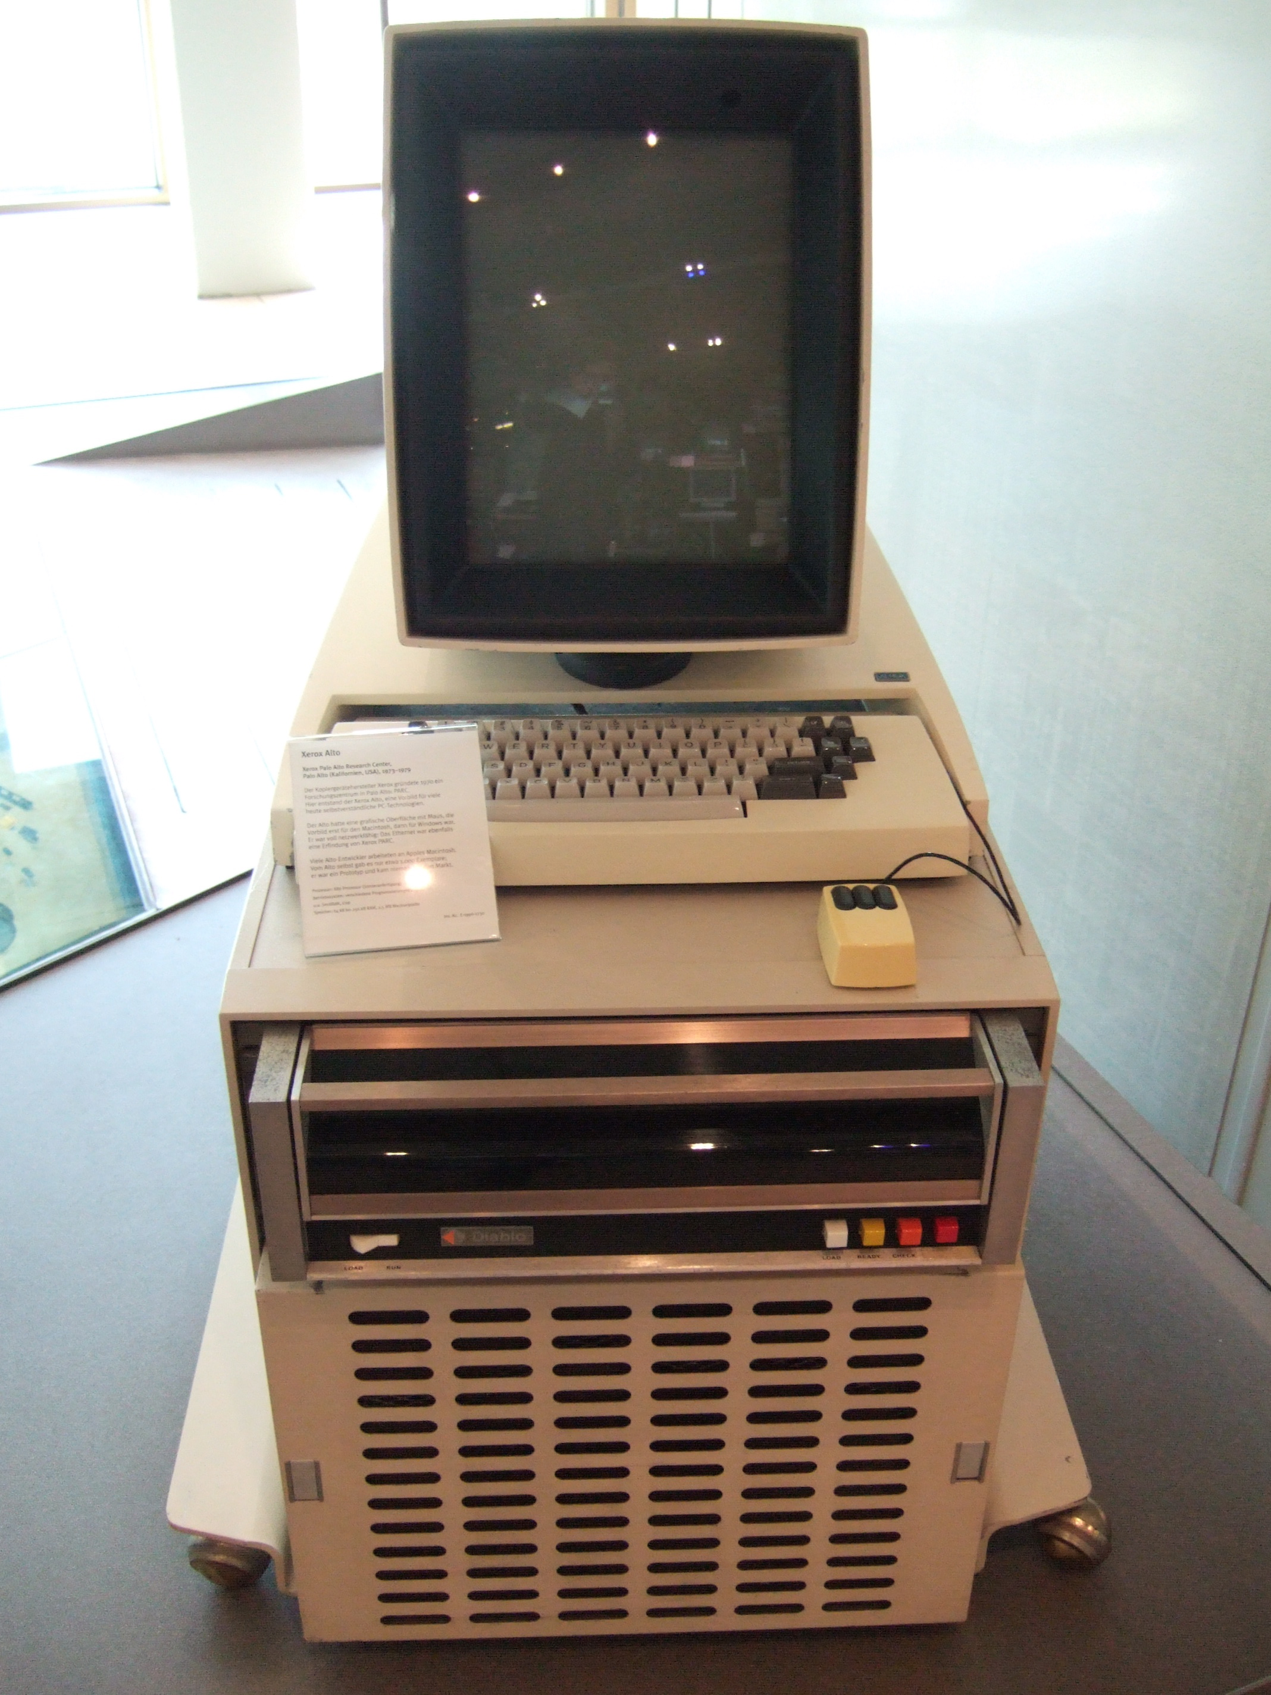
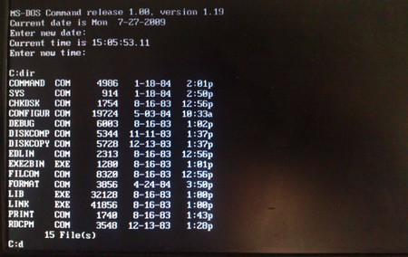
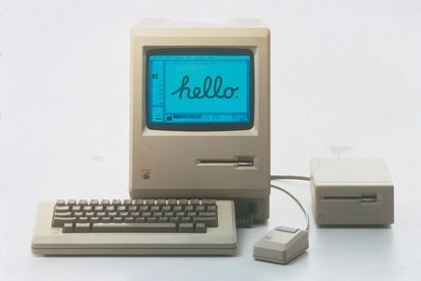
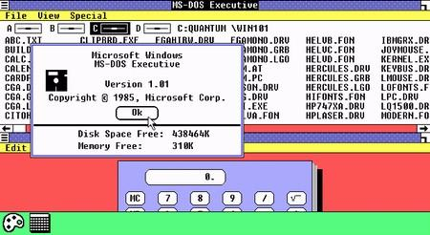
Operating System (History)
1973: Xerox Alto is the first computer designed from its inception to support an operating system based on a graphical user interface (GUI).
1977 – Apple II had Apple DOS
1981 – MS DOS
1984 – Mac OS
1985 – Windows 1.0

Slide 6
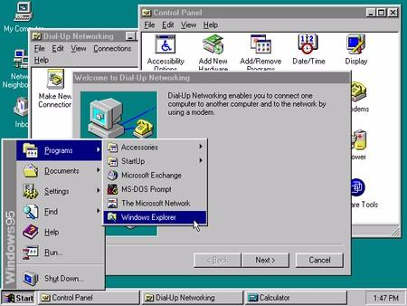
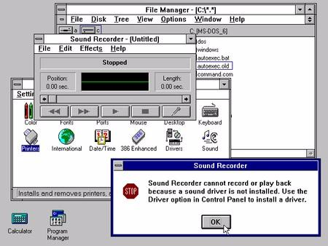
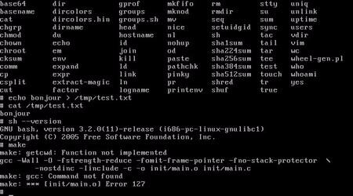
Operating System (History)
The year 1991 brought the first Linux version 0.01
1992 – Windows 3.1
1995 – Windows 95

Slide 7
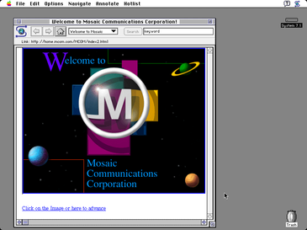
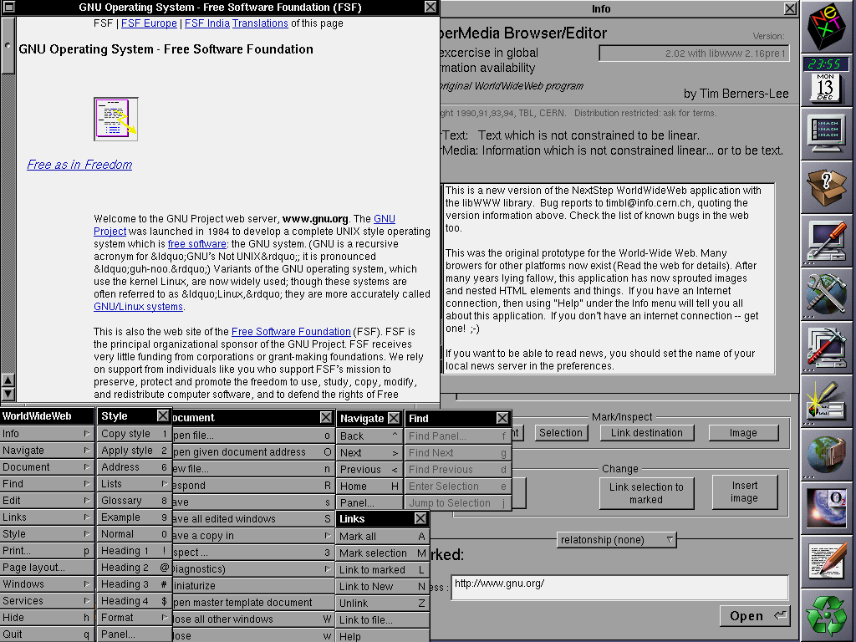
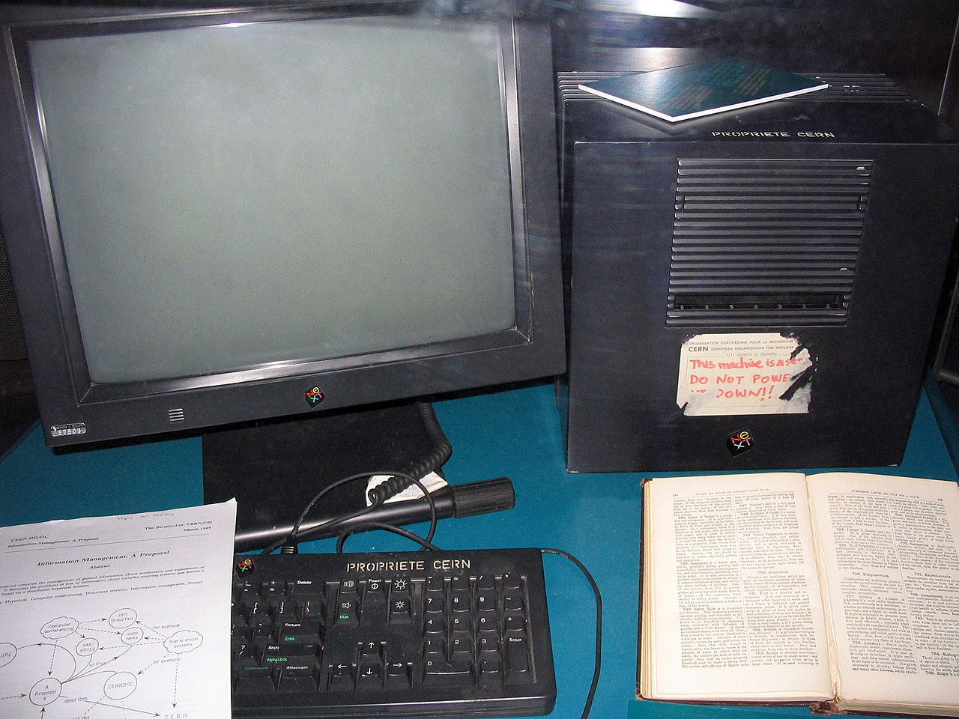
History of Web Browsers
In 1990 Tim Berners-Lee developed both the first web server, and the first web browser, called WorldWideWeb (later renamed Nexus).
In 1992 the Lynx browser was announced.
In September 1993 Marc Andreessen's developed Mosaic (later Netscape), credited with sparking the internet boom of the 1990s. It was the first web browser to display images inline with the document's text.

Slide 8
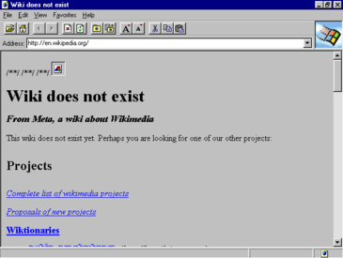
History of Web Browsers
Marc Andreessen, the leader of the Mosaic team at NCSA, quit to form Netscape Communications Corporation. Netscape released its flagship Navigator product in October 1994.
On 16 August 1995 Microsoft released version 1.0 of Internet Explorer.
This began what is known as the "browser wars" in which Microsoft and Netscape competed for the Web browser market.
Google released its Chrome Browser in 2008

Slide 9
Browser Market Share Timeline

Slide 10
Architecture of a Browser

Slide 11
Computer Programming
Computer programming is the process of designing and building an executable computer program to accomplish a specific computing result.
Computer Programming usually includes the following activities:
Coding
Debugging
Testing
Documentation
Maintenance

Slide 12
Programming Languages
There are 3 types of programming languages:
Machine Language
Assembly Language
High Level Language

Slide 13
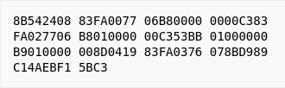
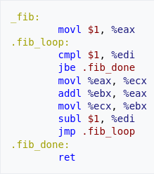
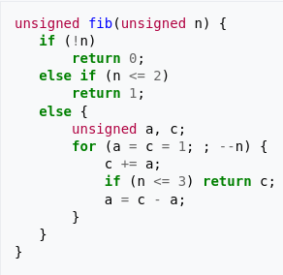
A function to calculate the nth Fibonacci number
Machine Code
Assembly Language
C Language

Slide 14
High Level Programming Languages
High-level language provides abstraction from machine language. Rather than dealing with registers, memory addresses and call stacks, high-level languages deal with:
Variables
Arrays
Objects
Expressions
Functions
Loops

Slide 15
Things to do before next session
Install VS Code
Install Git
Setup a GitHub Account
Create a Repository in GitHub
Clone the created repository in a local directory
Install SourceTree (Optional. You figure out yourself what it is and if feel excited install it or just leave it)

Slide 16
Next Session
Variables in JavaScript (var, let and const)
Data Types
Expressions
Functions
Arrays
Loops

